Slide 1
Groups Communities Clusters
Meso Level

Slide 2
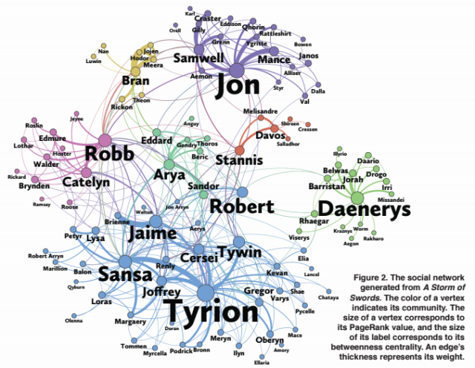
Levels of Analysis (Scales)
Micro:
  Vertex, dyad, triad
    Local processes
Macro:
  Whole network
    Emergent, global
Meso:
  Groups, communities, organizations, subgraphs
    In between local and global

Slide 3
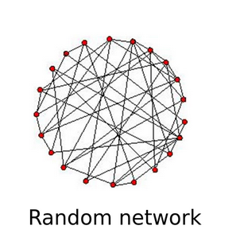
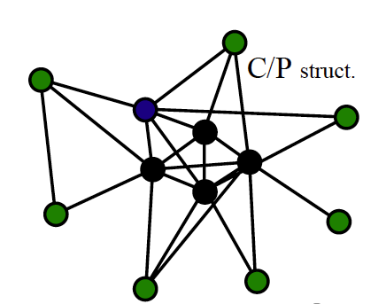
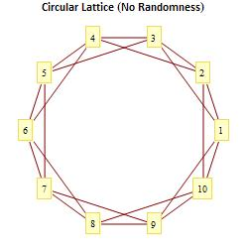
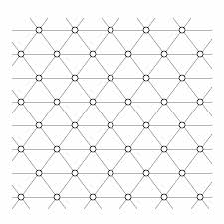
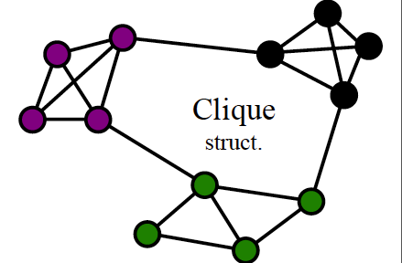
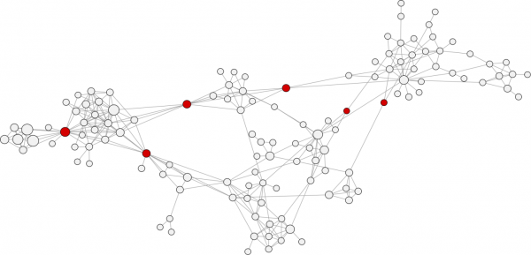
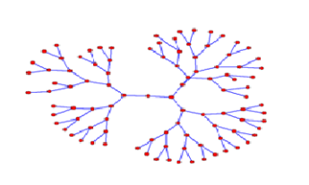
Meso Level Structures
Group, community, cluster, cliques
Core-periphery structure
Overlapping circles structure
Hierarchy (trees)
Strings
Lattices

Slide 4
Communities / Clusters / Groups
Like islands with bridges between
Few edges between clusters, many edges within clusters
Dense areas and sparse areas
Cliques

Slide 5
How can we identify communities within a network?
Vertex trait: Within cluster trait homophily
  Trait homogeneity within cluster
Edge connectivity
  Few edges between clusters, many edges within clusters

Slide 6
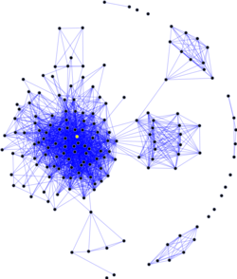
What are “groups” or “communities”?
“Group,” is a fuzzy social science concept, with many overlapping but sometimes contradictory verbal definitions
  As always graph theory to the rescue!
The graph theoretic concept of group/community is:
  A relatively dense subgraph featuring more links among the subset of vertices that belong to the subgraph than links to vertices in the rest of the graph

Slide 7
Graphs and subgraphs
A graph G' = (V', E') is a subgraph of a graph G = (V, E) iff:
  V' is a subset of V and E' is a subset of E
A lot of network methods are designed to split a graph into subgraphs
  Subgraphs can be used to represent the social network concepts of groups, cliques, or communities

Slide 8
Graphs and subgraphs
A graph G' = (V', E') is a subgraph of a graph G = (V, E) iff:
  V' is a subset of V and E' is a subset of E
A lot of network methods are designed to split a graph into subgraphs
  Subgraphs can be used to represent the social network concepts of groups, cliques, or communities
This is a subgraph

Slide 9
Graphs and subgraphs
A graph G' = (V', E') is a subgraph of a graph G = (V, E) iff:
  V' is a subset of V and E' is a subset of E
A lot of network methods are designed to split a graph into subgraphs
  Subgraphs can be used to represent the social network concepts of groups, cliques, or communities
This is another subgraph

Slide 10
Graphs and subgraphs
A graph G' = (V', E') is a subgraph of a graph G = (V, E) iff:
  V' is a subset of V and E' is a subset of E
A subgraph is connected if every node within it can reach every other one via a path of some length
This subgraph is connected

Slide 11
Graphs and subgraphs
A graph G' = (V', E') is a subgraph of a graph G = (V, E) iff:
  V' is a subset of V and E' is a subset of E
A subgraph is connected if every node within it can reach every other one via a path of some length
  Otherwise it is disconnected
This subgraph is disconnected :(

Slide 12
Graphs and subgraphs
A graph G' = (V', E') is a subgraph of a graph G = (V, E) iff:
  V' is a subset of V and E' is a subset of E
A subgraph is maximal with respect to a given property
  (e.g., connectivity)
if adding more nodes or links to the subgraph will mean it no longer has that property
This is a maximal subgraph of order 7

Slide 13
Cliques
A graph G' = (V', E') is a subgraph of a graph G = (V, E) iff:
  V' is a subset of V and E' is a subset of E
A clique is a maximal complete subgraph (density = 1.0)
  The size of a clique is the number of nodes in it:
    3-clique, 4-clique, 5-clique...k-clique
This is a clique of size 4

Slide 14
Cliques
This is a clique of size 5
A graph G' = (V', E') is a subgraph of a graph G = (V, E) iff:
  V' is a subset of V and E' is a subset of E
A subgraph is connected if every node within it can reach every other one via a path of some length
A clique is a maximal complete subgraph (density = 1.0)
  The size of a clique is the number of nodes in it:
    3-clique, 4-clique, 5-clique...k-clique

Slide 15
Cliques
A graph G' = (V', E') is a subgraph of a graph G = (V, E) iff:
  V' is a subset of V and E' is a subset of E
A subgraph is connected if every node within it can reach every other one via a path of some length
A clique is a maximal complete subgraph (density = 1.0)
  The size of a clique is the number of nodes in it
A closed triad is a clique of size 3!

Slide 16
Cliques
A graph G' = (V', E') is a subgraph of a graph G = (V, E) iff:
  V' is a subset of V and E' is a subset of E
A subgraph is connected if every node within it can reach every other one via a path of some length
A clique is a maximal complete subgraph (density = 1.0)
  The size of a clique is the number of nodes in it
Actors can belong to multiple cliques!

Slide 17
Cliques
Some subgraphs are not complete graphs (cliques) but they are almost there!
  They are quasi-groups
We can relax the definition to accommodate
  An n-clique is a subgraph where each node is at least n steps away from each other node
    3-clique, 4-clique, 5-clique...k-clique

Slide 18
Cliques
Some subgraphs are not complete graphs (cliques) but they are almost there!
  They are quasi-groups
We can relax the definition to accommodate
  An n-clique is a subgraph where each node is at least n steps away from each other node
    3-clique, 4-clique, 5-clique...k-clique
This is a 2-clique!

Slide 19
Cliques
Some subgraphs are not complete graphs (cliques) but they are almost there!
  They are quasi-groups
We can relax the definition to accommodate
  An n-clique is a subgraph where each node is at least n steps away from each other node
    3-clique, 4-clique, 5-clique...k-clique
This is a 3-clique!

Slide 20
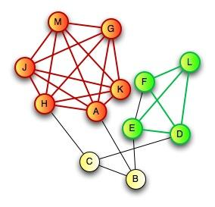
What is a clique?
A subset of N vertices with a density of 1
  All ties among all vertices
  Within group vertices have equal degree
  Triangle is a clique: a clique of size 3
  can have cliques of size 4, 5, 6 ????
  K-Core and N-Cliques
    What if 1 tie is missing? Is set of vertices no longer a clique?
    Allow some missing edges (density/degree threshold) -- K-Core
    N-cliques: 2-clique, everyone can reach every other member of the clique is 2 hops or less
  Overlapping cliques (social circles)

Slide 21
Graph connectivity
A graph is connected if there exists a (finite) path between each pair of nodes
This is a connected graph!

Slide 22
Graph connectivity
A graph is connected if there exists a (finite) path between each pair of nodes
  Otherwise the graph is disconnected
This graph is disconnected :(

Slide 23
Graph connectivity: Components
A graph is connected if there exists a (finite) path between each pair of nodes
  Otherwise the graph is disconnected
A maximal connected subgraph is called a component
  If a graph has more than one component it is by definition disconnected
These are two different components

Slide 24
Graph connectivity: Components
A graph is connected if there exists a (finite) path between each pair of nodes
  Otherwise the graph is disconnected
A maximal connected subgraph is called a component
  If a graph has more than one component it is by definition disconnected
These are three different components

Slide 25
Graph connectivity: Components
A graph is connected if there exists a (finite) path between each pair of nodes
  Otherwise the graph is disconnected
A maximal connected subgraph is called a component
  If a graph has more than one component it is by definition disconnected
The connected subgraph containing the largest number of vertices in a graph is called the giant component
This is the giant component!

Slide 26
Graph connectivity: Components
A maximal connected subgraph is called a component
The connected subgraph that contains the largest proportion of vertices is called the giant component
  A component is k-connected if every node in the component can reach any other one via a path of length k or less
This component is 2-connected!

Slide 27
Graph connectivity
We can disconnect a graph by removing edges

Slide 28
Graph connectivity
Oops! Disconnected!
We can disconnect a graph by removing edges

Slide 29
Graph connectivity
We can disconnect a graph by removing edges

Slide 30
Graph connectivity
We removed some edges
We can disconnect a graph by removing edges
Is this graph disconnected?

Slide 31
Graph connectivity
We can disconnect a graph by removing edges
Now it is!

Slide 32
Graph connectivity
This is a bridge
We can disconnect a graph by removing edges
In some graphs removing just one edge leads to disconnection
  Edges with the property of being able to disconnect the graph upon removal are called bridges

Slide 33
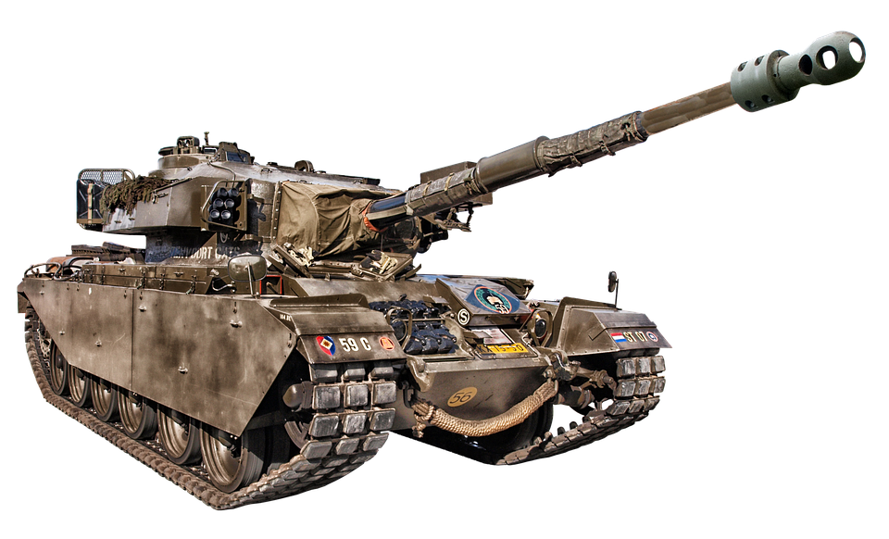
Graph connectivity
We can also disconnect a graph by removing nodes

Slide 34
Graph connectivity
Oops! Disconnected!
We can also disconnect a graph by removing nodes

Slide 35
Graph connectivity
Oops! Disconnected!
We can also disconnect a graph by removing nodes
  It can be easier to disconnect a graph this way because nodes take their links with them!

Slide 36
Graph connectivity
We can also disconnect a graph by removing nodes
  Some nodes are more “important” for because they serve as the connectors
  Can you guess what kind of centrality “connector” nodes are more likely to have?
VIP Node
Not VIP

Slide 37
Graph connectivity
We can also disconnect a graph by removing nodes
  Some nodes are more “important” because they serve as the connectors
A graph is k-connected if it takes removing k nodes to disconnect it
This graph is 1-connected

Slide 38
Graph connectivity
We can also disconnect a graph by removing nodes
  Some nodes are more “important” because they serve as the connectors
A graph is k-connected if it takes removing k nodes to disconnect it
This graph is 2-connected

Slide 39
Graph connectivity
We can also disconnect a graph by removing nodes
  Some nodes are more “important” because they serve as the connectors
A graph is k-connected if it takes removing k nodes to disconnect it
This graph is 2-connected

Slide 40
Graph connectivity
We can also disconnect a graph by removing nodes
  Some nodes are more “important” because they serve as the connectors
A graph is k-connected if it takes removing k nodes to disconnect it
This graph is 3-connected

Slide 41
Graph connectivity
We can also disconnect a graph by removing nodes
  Some nodes are more “important” because they serve as the connectors
A graph is k-connected if it takes removing k nodes to disconnect it
This graph is 3-connected

Slide 42
Graph connectivity: Cutsets
Some graphs are easy to disconnect
  Only require the removal of a few links or nodes
Others are hard to disconnect
  Requires the removal of a lot of links or nodes
The edge-cutset is the minimum number of edges required to disconnect a graph
  What’s the edge-cutset of the graph on the right?

Slide 43
Graph connectivity: Cutsets
Some graphs are easy to disconnect
  Only require the removal of a few links or nodes
Others are hard to disconnect
  Requires the removal of a lot of links or nodes
The edge-cutset is the minimum number of edges required to disconnect a graph
  What’s the edge-cutset of the graph on the right?
|Edge-cutset| = 2

Slide 44
Graph connectivity: Cutsets
Some graphs are easy to disconnect
  Only require the removal of a few links or nodes
Others are hard to disconnect
  Requires the removal of a lot of links or nodes
The node-cutset is the minimum number of nodes required to disconnect a graph
  What’s the node-cutset of the graph on the right?

Slide 45
Graph connectivity: Cutsets
Some graphs are easy to disconnect
  Only require the removal of a few links or nodes
Others are hard to disconnect
  Requires the removal of a lot of links or nodes
The node-cutset is the minimum number of nodes required to disconnect a graph
  What’s the node-cutset of the graph on the right?
|node-cutset| = 1

Slide 46
Graph connectivity: Cutsets
For a pair of non-adjacent nodes, u and v:
  The UV node cutset is the number of nodes that would have to be removed for them to be disconnected
U
V
K = 1
U
V
K = 2
U
V
K = 3

Slide 47
Graph connectivity: Cutsets
For a pair of non-adjacent nodes, u and v:
  The UV node cutset is the number of nodes that would have to be removed for them to be disconnected
Menger’s theorem states that:
  If a graph is k-connected there are at least k paths that don’t repeat third nodes connecting each non-adjacent pair of nodes
    This is an important result in graph theory!
This graph is 3-connected

Slide 48
Graph connectivity: Cutsets
For a pair of non-adjacent nodes, u and v:
  The UV node cutset is the number of nodes that would have to be removed for them to be disconnected
Menger’s theorem states that:
  If a graph is k-connected there are at least k paths that don’t repeat third nodes connecting each non-adjacent pair of nodes
    This is an important result in graph theory!
That means these two green persons are indirectly connected in three separate ways!

Slide 49
Graph connectivity: Cutsets
For a pair of non-adjacent nodes, u and v:
  The UV node cutset is the number of nodes that would have to be removed for them to be disconnected
Menger’s theorem states that:
  If a graph is k-connected there are at least k paths that don’t repeat third nodes connecting each non-adjacent pair of nodes
    This is an important result in graph theory!
1
That means these two green persons are indirectly connected in three separate ways!

Slide 50
Graph connectivity: Cutsets
For a pair of non-adjacent nodes, u and v:
  The UV node cutset is the number of nodes that would have to be removed for them to be disconnected
Menger’s theorem states that:
  If a graph is k-connected there are at least k paths that don’t repeat third nodes connecting each non-adjacent pair of nodes
    This is an important result in graph theory!
2
That means these two green persons are indirectly connected in three separate ways!

Slide 51
Graph connectivity: Cutsets
For a pair of non-adjacent nodes, u and v:
  The UV node cutset is the number of nodes that would have to be removed for them to be disconnected
Menger’s theorem states that:
  If a graph is k-connected there are at least k paths that don’t repeat third nodes connecting each non-adjacent pair of nodes
    This is an important result in graph theory!
3
That means these two green persons are indirectly connected in three separate ways!

Slide 52
Graph connectivity: Cutsets
K-connectivity (graph theory) can represent concept of social cohesion (network theory):
  The larger the (edge, node) cutset the more cohesive (integrated) groups are with one another
  The smaller the (edge, node) cutset the less cohesive and more potentially fragmented the group structure is

Slide 53
Graph connectivity: Cutsets
K-connectivity (graph theory) can represent concept of social cohesion (network theory):
  The more k-connectivity the more cohesive (integrated) the group
    More people would have to be removed to disrupt the group
  Any graph can be split into subgraphs with any given level of k-connectivity

Slide 54
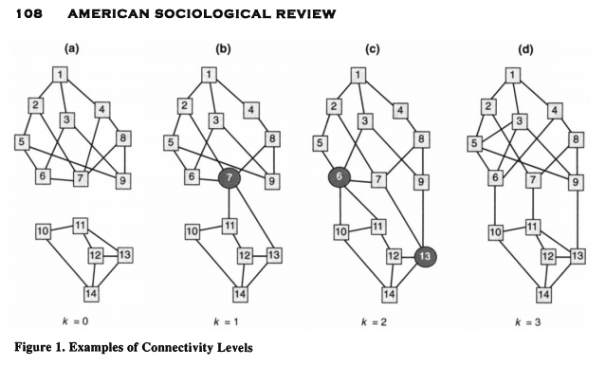
Graph connectivity: Cutsets

Slide 55
Communities
Like islands with bridges between
Few edges between clusters, many edges within clusters
Dense areas and sparse areas

Slide 56
Community Detection
Vertex trait: Within cluster trait homophily
  population homogeneity
  ideational solidarity
Edge connectivity
  Principle: Few edges between clusters, many edges within clusters

Slide 57
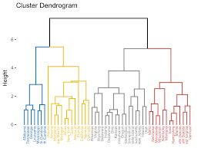
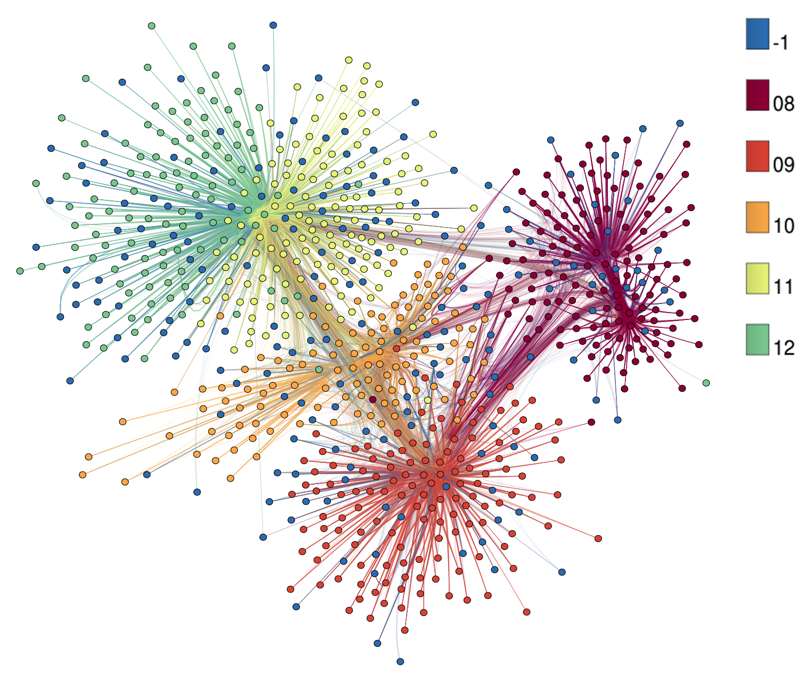
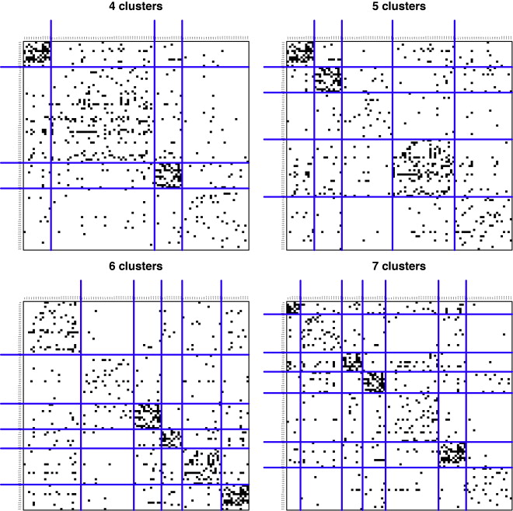
Methods for Identifying Communities
Cohesive Block Modeling
Block Modeling
Hierarchical Clustering
Optimization Algorithms

Slide 58
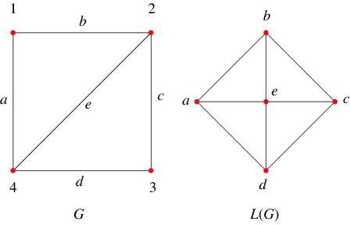
Matrix Representation: Line graphs
For any given graph G = (V, E) with N vertices and M Edges represented by adjacency matrix A of dimensions N x N:
  We may obtain the corresponding line graph (or edge graph, edge adjacency matrix) by:
    Creating a graph L(G) represented by adjacency matrix B, of dimensions M x M with:
      B_{ij} = 1 if e_{i} and e_{j} share a common vertex v_{k}
      B_{ij} = 0 if e_{i} and e_{j} do not share a common vertex

Slide 59

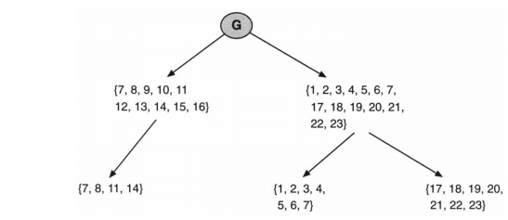
Cohesive Blocking
Identify the k-connectivity of the input graph
Remove the k-cutset (vertices)
Do the same on the resulting subgraphs until no more subdivisions can be obtained

Slide 60
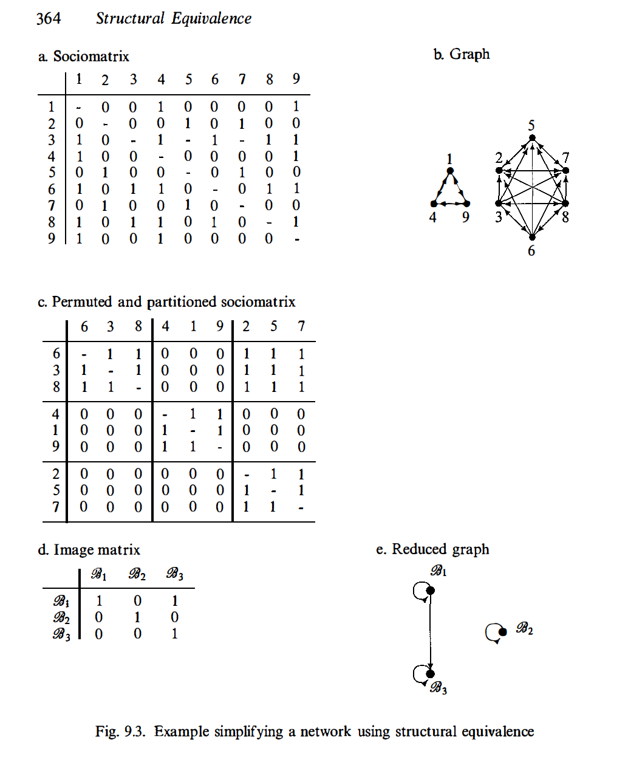
Block Modelling
Permute the matrix by rearranging rows and columns
Partition into high (all 1s) and low (all 0s) density blocks
Communities fall along the main diagonal

Slide 61
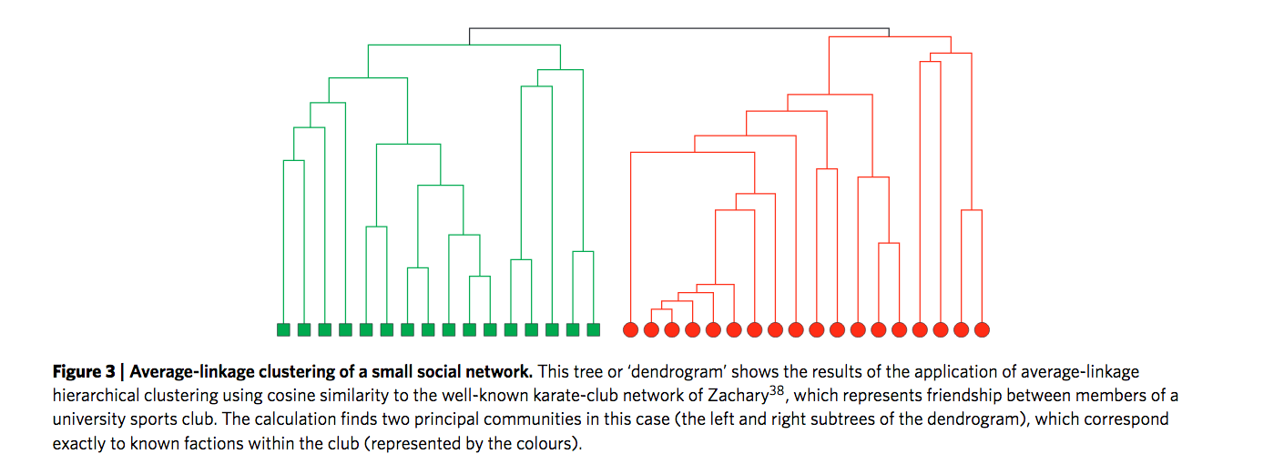
Hierarchical Clustering
Compute similarity between all pairs of vertices in terms of ties to all other vertices
Use a clustering algorithm to group “similar” vertices together

Slide 62
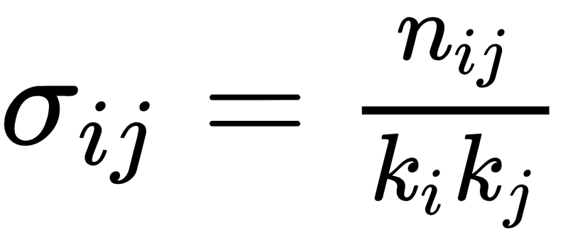
Hierarchical Clustering
  Clustering as much of an art as a science
  Steps:
    Develop a criterion of similarity between nodes such that more strongly connected vertices receive higher values
      For instance cosine similarity:
      Where n_{ij} is number of common neighbors between i and j and k is degree
    Hierarchical clustering on that distance matrix will produce a partitioning of the vertices into classes

Slide 63

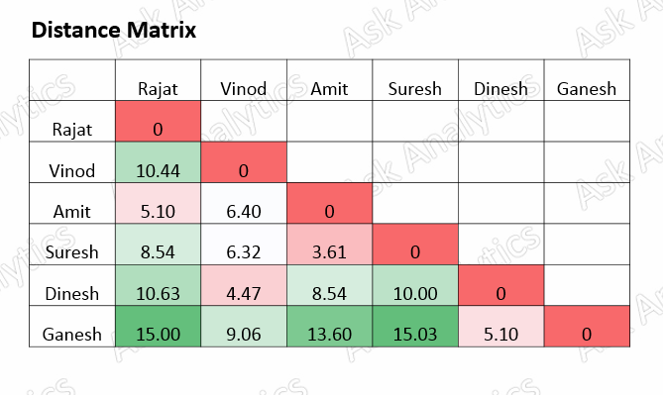
Hierarchical Clustering
Could instead use Euclidean distance:
Where a_{ix} = 1 if i is connected to x
Or
Correlation distance (as in CONCOR)
Number of shared contexts or groups (in a one-mode projection)
Graph-theoretic distance (e.g. shortest paths)
Vertex attributes

Slide 64
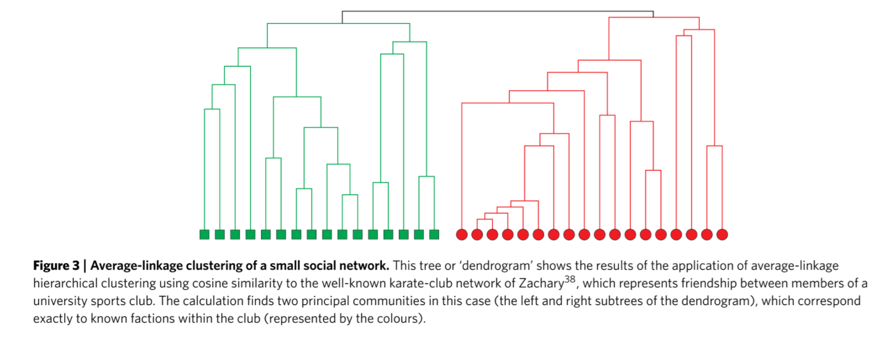
Hierarchical Clustering

Slide 65
Hierarchical Clustering
Hierarchical clustering approaches have many appealing properties
  They are simple
  They recover fundamental intuitions about our understanding of groups such as the fact that they are hierarchical and nested
However,
  Sensitive to initial similarity measure chosen
  Sensitive to clustering criterion used (e.g. single-linkage, complete-linkage, average, etc.)
    When in doubt go with average?
  Clustering approaches don’t know what to do with weakly connected nodes

Slide 66
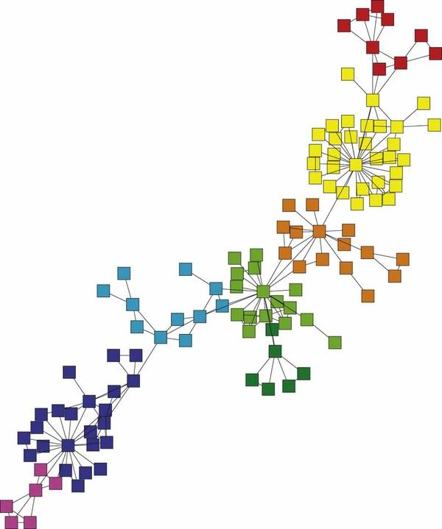
Modularity and Community Detection
The basic idea is that a network has "community structure" if the edges are arranged in a "statistically surprising" way
  A quantity known as the modularity can be used for this purpose

Slide 67
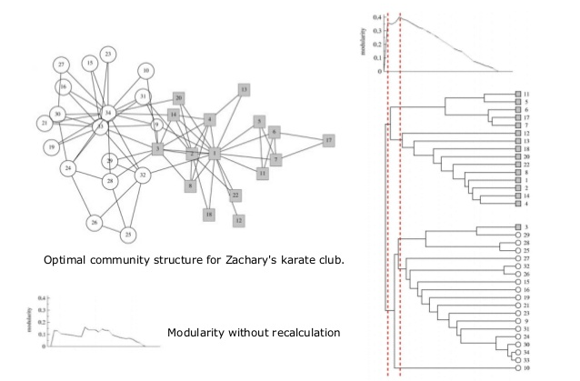
Algorithms
Minimize between cluster edges, maximize within cluster edges
Clauset-Newman-Moore: modularity (Q)
Girvan-Newman: edge betweeness
  Identify edges with highest edge betweenness
  Remove that edge
  Iterate

Slide 68
Modularity and Community Detection
In words, for a partition of the graph into C groups, the modularity is defined as:
  The observed number of edges falling within groups minus the expected number of edges in the same network if these were placed at random
    Configuration Model
  Positive values indicate the presence of community structure

Slide 69


Modularity and Community Detection
In a network the observed number of edges between vertices i and j is given by the corresponding entry in the adjacency matrix Aij (usually 0 or 1)
The expected number of edges between i and j is simply a function of their respective degrees:

Slide 70


Modularity and Community Detection
The modularity (Q) is then given by the sum of the difference between observed minus expected across each pair of vertices that belong to the same group:
Where s_{i}= 1 if vertex i belongs to group 1 and s_{i}= -1 if vertex belongs to group 2
The matrix containing observed minus expected differences for each pair of vertices is known as the modularity matrix:

Slide 71
Modularity and Community Detection
Newman (2006) proposes an algorithm for partitioning a network into two communities based on the B matrix:
  Compute the leading eigenvector of the modularity matrix
    For a matrix the leading eigenvector is the one associated with the largest (most positive) eigenvalue following a factorization of the matrix
  Assign vertices into two disjoint groups based on the sign of the corresponding element in the vector
    Vertices with positive values go in one group
    Vertices with negative values go into the other group
  Compute modularity Q
  Repeat for each group and compute modularity Q to see if there is a change in modularity as a result of the next division

Slide 72
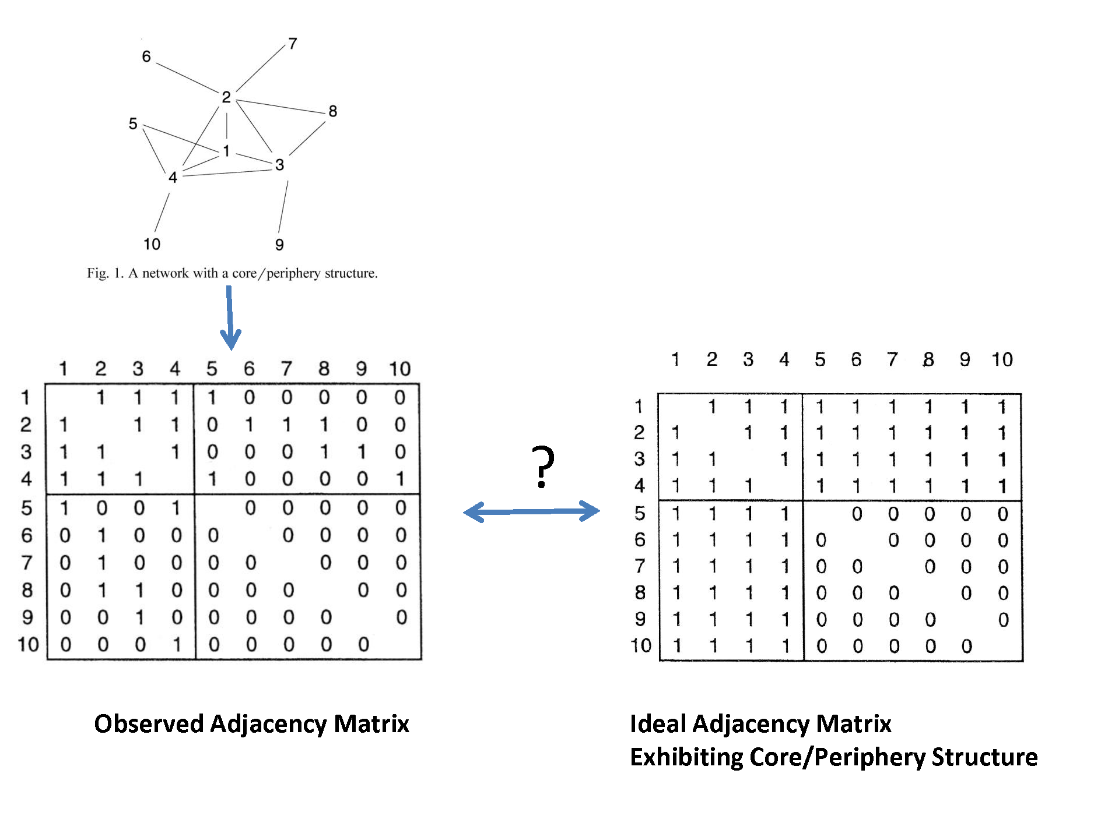
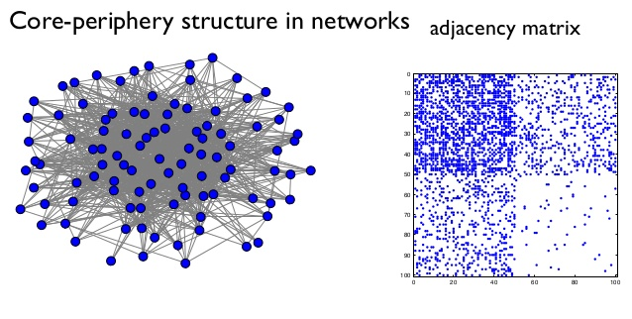
Core-Periphery Structure

